Slide 1

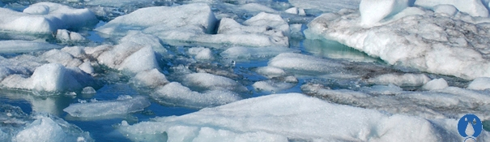
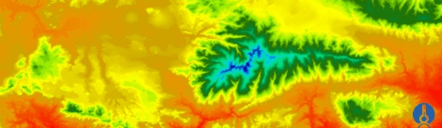
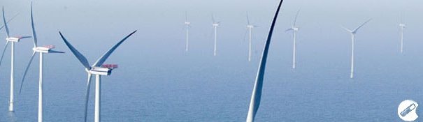

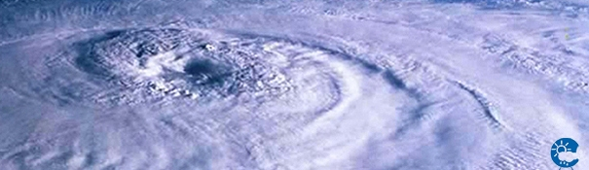
ENEON first workshop
Observing Europe: Networking the Earth Observation Networks in Europe
21-22 September, Paris
Arctic Monitoring and Assessment Programme (AMAP)
Simon Wilson (s.wilson@inter.nl.net)

Slide 2
1. About your network
1.1 What network are you representing and what is your role in this network?
1.2 What are the main objectives of the network?
AMAP: Arctic Monitoring and Assessment Programme (www.amap.no)
Arctic Council (www.arctic-council.org)
(Canada – Denmark/Greenland – Finland – Iceland – Norway – Russia – United States)
To monitor and assess the status of the Arctic region with respect to pollution and climate change issues.
To document levels and trends, pathways and processes, and effects on ecosystems and humans, and propose actions to reduce associated threats for consideration by governments.
To produce sound science-based, policy-relevant assessments and public outreach products to inform policy and decision-making processes.

Slide 3
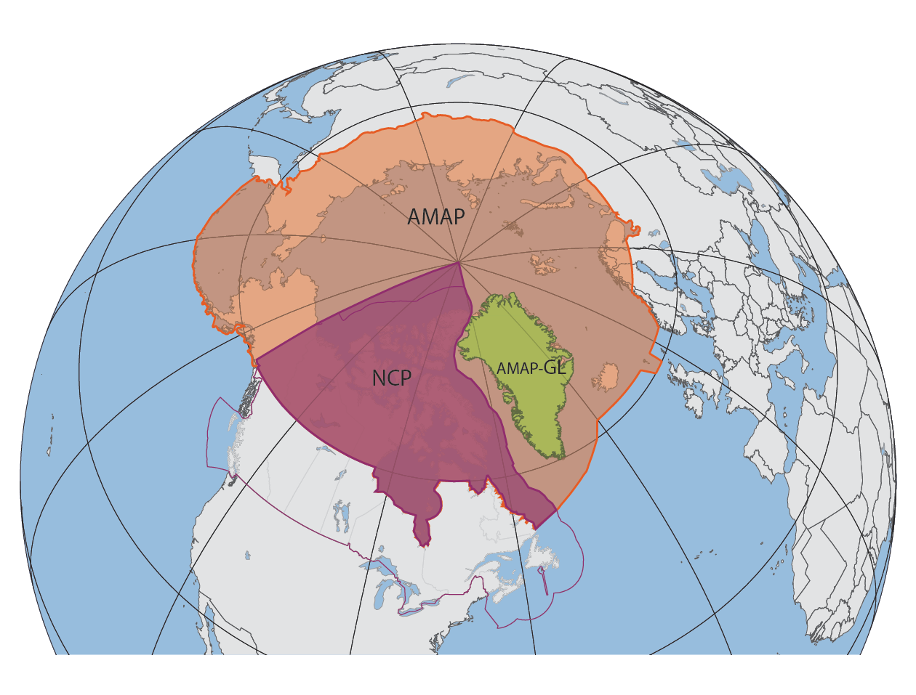
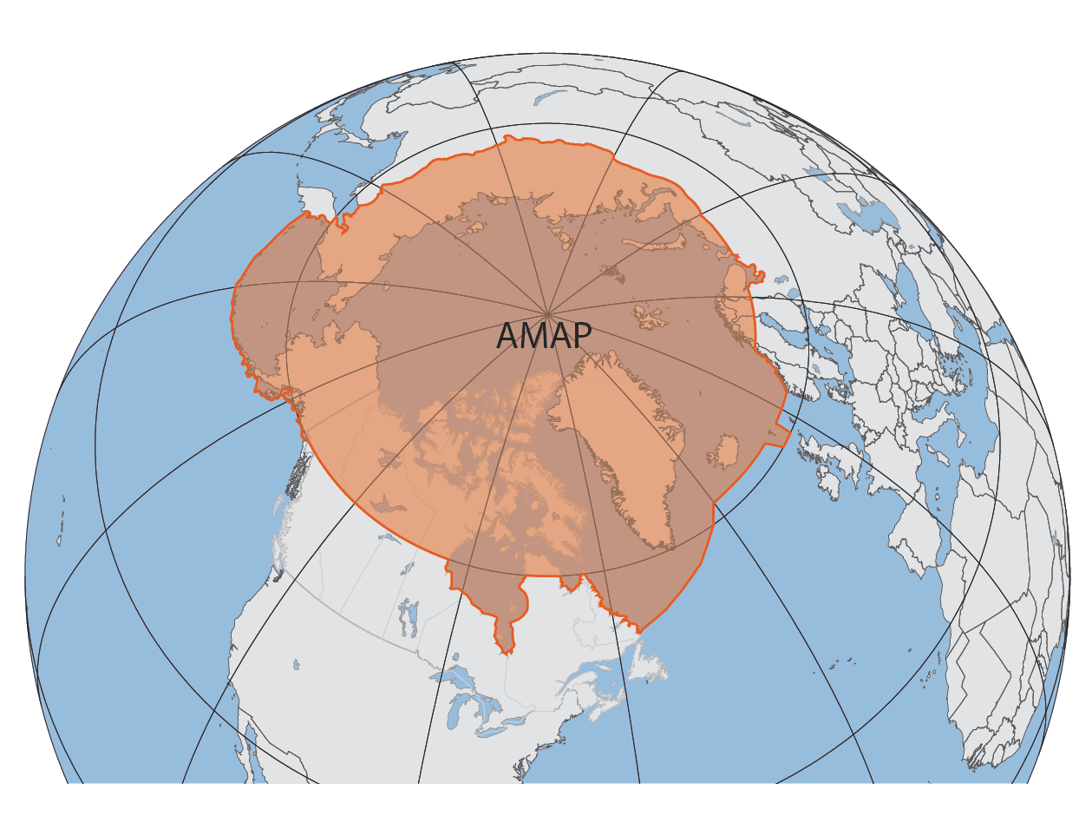
National implementation
1. About your network
1.3 Who are the main contributors to your network?
1.4 What form of commitment do you have for the maintenance your network?
1.5 How large is your user base and who are your users?
Arctic countries / Observing countries / + +
Monitoring/research: Based on national activities; Harmonization where necessary
Users: AMAP assessment groups; Arctic scientific community; Global scientific community; Support for international processes (UNFCCC, Stockholm Convention, etc.)

Slide 4
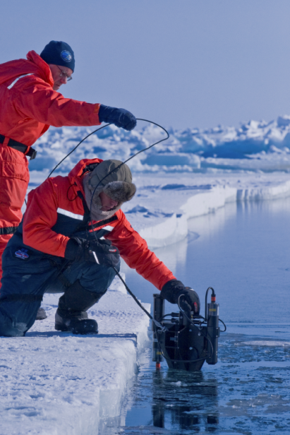
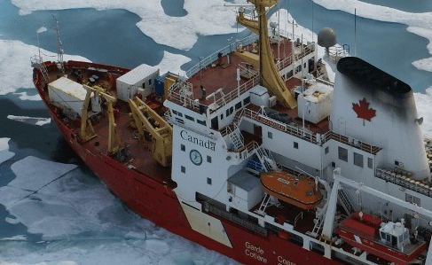
1. About your network
  1.6 Do you maintain a database of user needs and observational requirements?
  1.7 What are the costs and efforts of maintaining the network?
  1.8 What are your main funding sources?
  1.9 What are the key issues for sustainability of your network running?
Assessments identify gaps in knowledge/needs
Stakeholder consultation >> needs / co-design / TLK
Arctic observing is costly >> EO (remote) sensing
Direct funding (limited $) / In-kind ($???)
Arctic countries / Research funding (EU, NSF, etc.)
Sustained funding (> 3-year perspective)
(Re)direction of funding

Slide 5
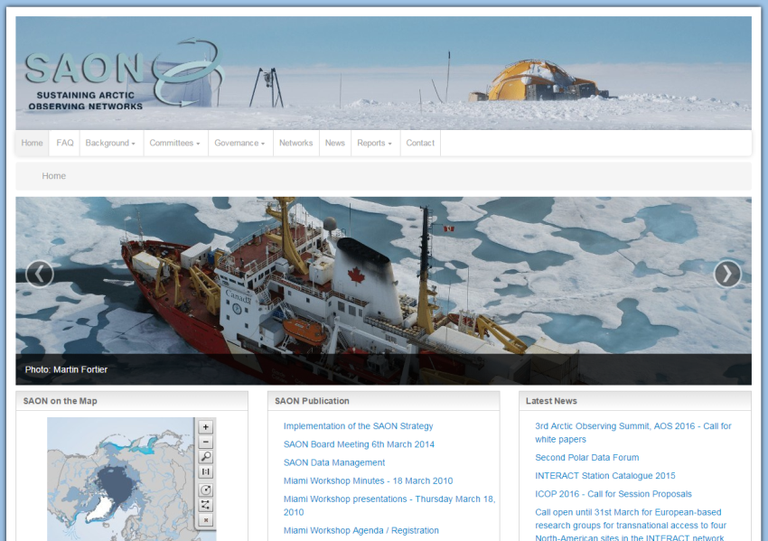
Sustaining Arctic Observing Networks (SAON)
What is SAON?
Promote vision of well-defined observing networks that enable users to have access to free, open and high quality data that will realize pan-Arctic and global value-added services and provide societal benefits.
Goal: Support and strengthen the development of multinational engagement for sustained and coordinated pan-Arctic observing and data sharing systems ...
Goal: Enhance Arctic-wide observing activities, facilitate partnerships and synergies among existing observing and data networks, promote sharing and synthesis of data and information.
Underway since early 2007
(Not a network of networks)
www.arcticobserving.org

Slide 6
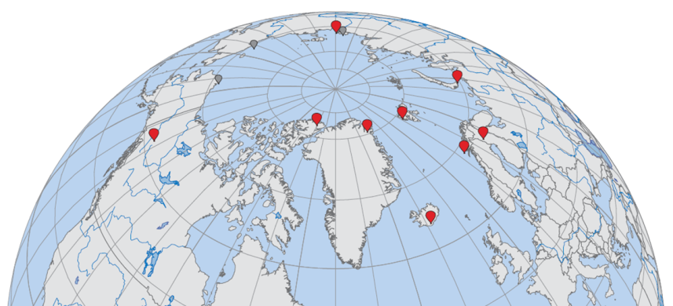
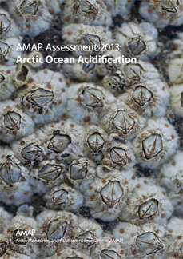
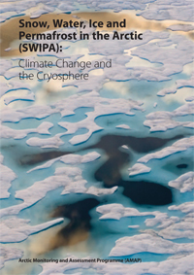
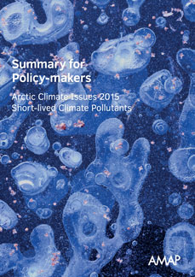
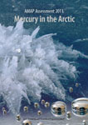
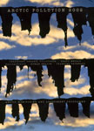
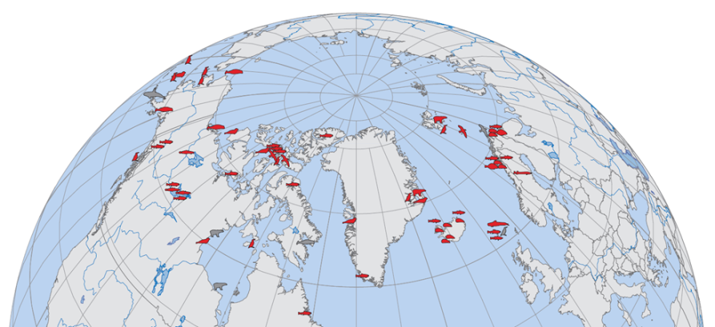
2. About data
  2.1 What observations does your network collect and what products are produced?
  2.2 What are the spatial and temporal characteristics and limits of your network?
‘Pollution’: environmental contaminants in abiotic media, biota, humans, etc.); effects parameters
‘Climate’: climate/cryosphere, Arctic-ECVs), radiatively-important trace species, short-lived climate forcers, ocean acidification, etc.
Socio-economic metrics, TLK
1990- (plus retrospective studies from ice cores, archived samples, etc.)
Geographical gaps

Slide 7
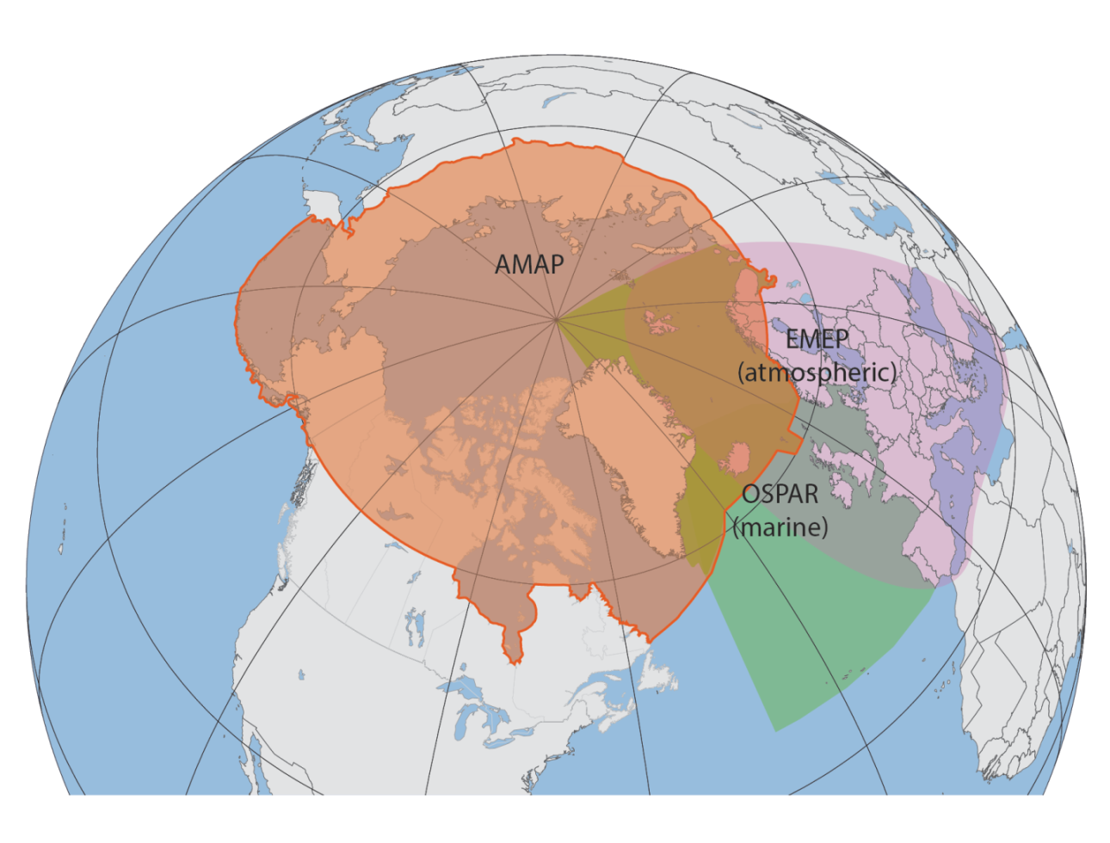
2. About data
  2.3 How is the data archived and made accessible to users?
  2.4 Do you address data quality in some way?
  2.5 Are there risk for data continuity and how are data preservation and network continuity addressed?
AMAP as a data producer
AMAP as a data user
Web-based data products
AMAP Thematic data centres (NILU/EBAS; ICES)
Regional cooperation; bridging national >> regional
Data management and inter-programme cooperation/harmonization; Sampling/laboratory QA/QC; Shared sites; Compatible methodology
NILU: http://ebas.nilu.no/
ICES: http://ecosystemdata.ices.dk/

Slide 8
2. About data
  2.6 What are the conditions (licenses) for sharing your data and products with users?
  2.7 What key interface standards are used in making data and products available?
  2.8 Are there known observational requirements that your network is not meeting?
  2.9 Are there observations that are needed but not captured by your network or by other networks that you have access to or products that are not generated?
Principles:
Free, open access to high quality data
Recognition of data ownership (publication)
International standards
Polar Information Commons (PIC), etc.
SAON Committees:
The Arctic Data Committee (ADC)
The Committee on Observations and Networks (CON)
Data gaps:
Better use of EOS (new initiatives – e.g. Polaris)
Socio-economic data (industry sources?)

Slide 9
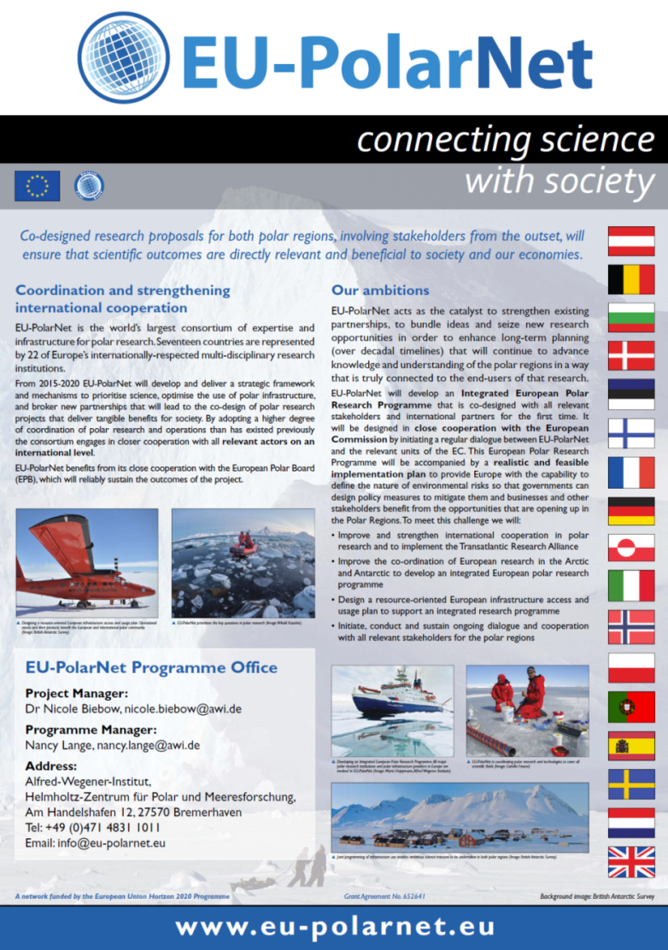
Objectives:
To establish an on-going dialogue between policy-makers, business and industry leaders, local communities and scientists to increase understanding and identify new ways of working that will deliver economic and societal benefits.
Develop a (2020-) Integrated European Research Programme, co-­designed with all relevant stakeholders and coordinated with the activities of polar research nations beyond Europe.
Develop an Implementation plan to provide Europe with the capability to define the nature of environmental risks so that governments can design policy measures to mitigate them and businesses and other stakeholders benefit from the opportunities that are opening up in the Polar Regions.
Work Package 1: International Integration and Policy Guidance
Work package 2: Polar Research for Science and Society
Work Package 3: Infrastructures, Facilities, and Data
Work Package 4: Interaction with Stakeholders

Slide 10
3. About a network of networks
  3.1 What coordination and collaboration interfaces do you have with other networks?
  3.2 Is your network contributing to GEO(SS) and if so, what is this contribution? Could ConnectinGEO help to enhance your contribution to GEOSS?
  3.3 Are there additional interfaces that would be desired and what would be the main benefits of these interfaces?
  3.4 Do you think that your network could benefit from the existence of an ENEON or a similar network?
  3.5 From you point of view, how should an ENEON be organized and managed?
Coordination and collaboration:
Global – WMO, UNEP, UNECE, IAEA, etc.
Regional - EMEP, OSPAR, IASC, etc.
Institutional – IIASA, ESA, EU-DGs
SAON:
SAON is viewed as the Arctic node of GEO
Organization:
Added-value, avoid duplication
Partner buy-in, acceptance
Role (hard line: top-down direction to networks; soft approach – promoting mutual-benefits (SAON)
Coordination of ENEON (European EO) with EU-PolarNet (European (Polar) Research)

Slide 11
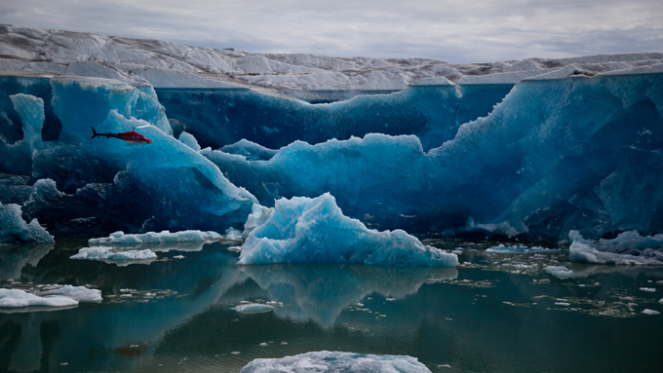
Thankyou for your attention

